Slide 1
Mortality Rate Analysis in United State Author: Pooja Sheth
Inspiration :
This analysis is triggered by the increasing interest of health sector industries in the field of data sciences, where increase in number (10%-20%) of health care industries investing in data analytics stake based solutions.
To understand the root cause of increasing mortality for the year 2015 in US, different social, ethnic and privacy factors are considered.
Problem Statement :
To study different parameters with potential privacy , social and ethnic issues responsible for higher mortality rate for the year 2015 for identified clusters of states.
Data Sources:
Mortality Rate (State, Age, Ethnic Group) Atmospheric Factors Hospital Parameters
Mortality Factors (Alcohol, Murder and Occupant Death Rate, Drug Poisoning) Fitness & Behavior Parameters
Reference:
www.data.gov www.bls.gov en.wikipedia.org
www.cdc.gov urc.fbi.gov

Slide 2
Data Practices, Potential Privacy & Ethical Issues
Data Transformation and Mining Techniques
Decomposing all datasets to similar grain – state level.
Cleaning, Restructuring and Merging different sources of data (various joins in tableau) to get desired output.
Normalizing of parameters based on population of each state.
Privacy & Ethical Issues
The objective of the analysis to determine mortality is based on racial, social and ethnic parameters, understanding which age and ethnic groups and what behavior patterns (Fitness Parameters) are affecting the mortality analysis.
One of the other parameters to understand the mortality rate is the number of hospitals and the emergency capacity which is a potential privacy concern, to analyze the hospital data by region.
The hospital data with their names and the patient names admitted for different diseases can be misused for various reasons. So, this analysis understands the privacy potentials concerns and hence no individual names or identity is disclosed.

Slide 3
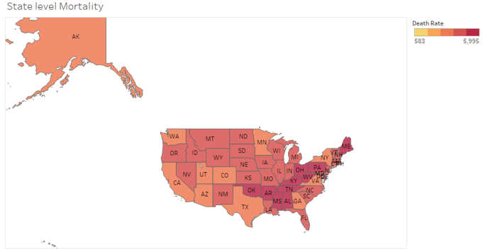
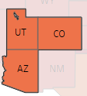
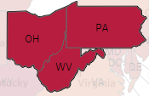
State Level Analysis
PRIMARY ANALYSIS
Here, we identify the 3 states with higher mortality rate and the 3 states with lower mortality rate.
These states would be used as basis of comparison for the further analysis, to understand as to why is the mortality rate higher in the identified states and lower in the other set of identified states based on some racial, ethnic and social stereotypes.
Lower Mortality rate 3 States: Higher Mortality rate 3 states:
Utah , Colorado , Arizona Ohio , west Virginia , Pennsylvania
Mortality rate = Number of Deaths per 100,000 Population

Slide 4
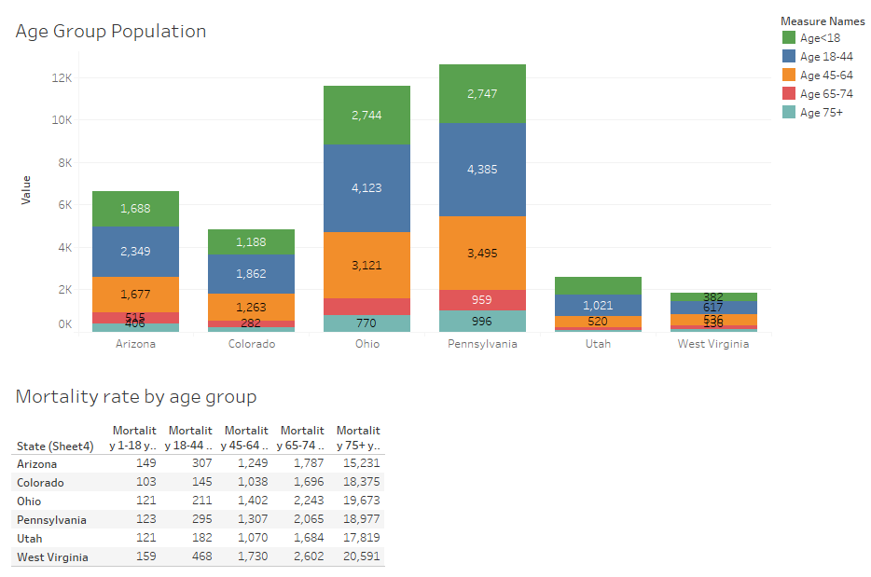
Age Group
PRIMARY ANALYSIS
Here, we identify the age group population for the identified states to understand, whether age is a significant factor or not.
It can be seen, two of the higher mortality states i.e. Ohio and Pennsylvania have higher population than the other states and even in individual age categories.
From the Mortality rate by age group it can be seen that, it’s highest in West Virginia State. Which leads us to explore other factors.
SECONDARY RESEARCH
There are more move outs from the state than move in, thus the decreasing population in West Virginia state.
West Virginia is the only state where death rates exceed birth rates.
Mortality rate increases with increasing age group.

Slide 5
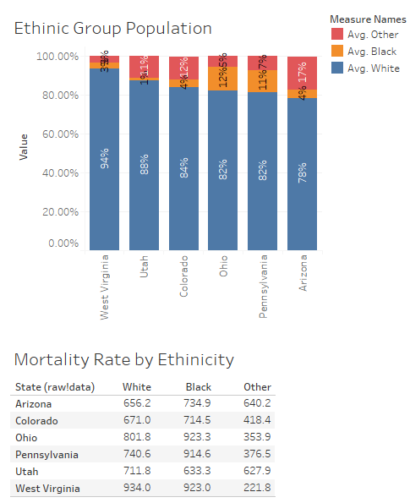
Ethnic groups
PRIMARY ANALYSIS
Here, we identify the ethnic group population for the identified states to understand, whether ethnic group is a significant factor or not.
It is observed that two of the higher mortality states Ohio and Pennsylvania have higher percentage of black ethnic group, But West Virginia which has the highest mortality rate has more number of blacks than any other states in the comparison group along with Ohio.
The data suggests that the 3 states with higher mortality rate have more population of black ethnic group than the US average.
Ethnic group is a significant factor.
US average of black ethnic group in each state is 849

Slide 6
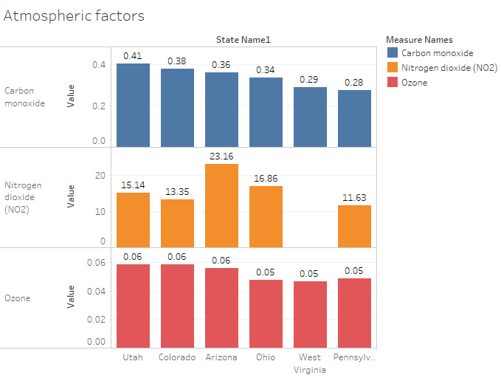
Atmospheric conditions
PRIMARY ANALYSIS
Here, we identify the influence of the atmospheric factors i.e. The content of Carbon monoxide, Nitrogen dioxide, Ozone , the color represents the factors.
From the bar graph it can be seen that the values aren’t much significant. But in the past there have been many deaths of people working in coal industries in West Virginia.
SECONDARY RESEARCH
West Virginia is a Oil& Gas and Coal mining industries state. A lot of people have died due to kidney and respiratory issues.

Slide 7
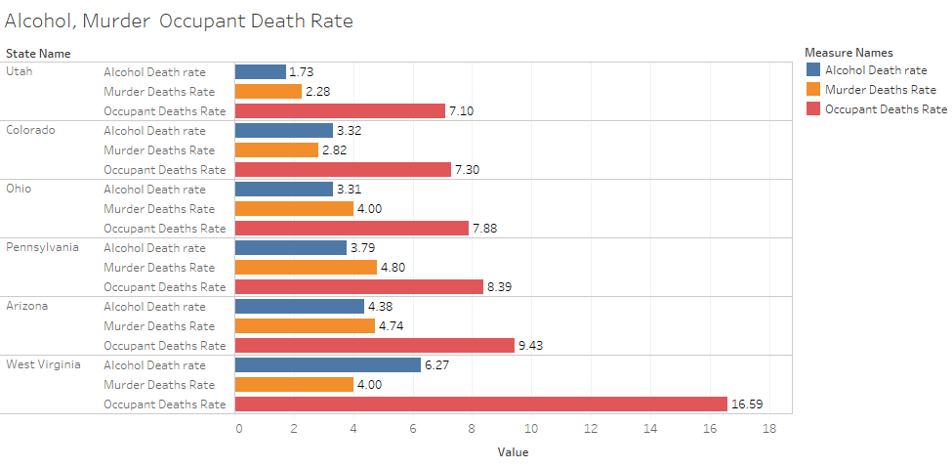
Alcohol , Murder & Occupant Deaths Rate
PRIMARY ANALYSIS
Here, we understand the mortality rate due to miscellaneous factors such as Alcohol abuse, Murder Crime rate and Occupant Death Rate.
From the bar graph it can be seen that apart from Arizona state all the 3 states with higher mortality rate have all of these factors high.
The data suggests that of all the 3 factors occupant deaths are quite common and higher in all the states and quite huge in West Virginia. Followed by the deaths due to alcohol abuse.
SECONDARY RESEARCH
Pregnant women’s consumption of alcohol has been high impacting the birth rate.
Mortality types | West Virginia Mortality Rate | US Mortality Rate
Murder | 4 | 4.8
Occupant Deaths | 16.59 | 10.2

Slide 8
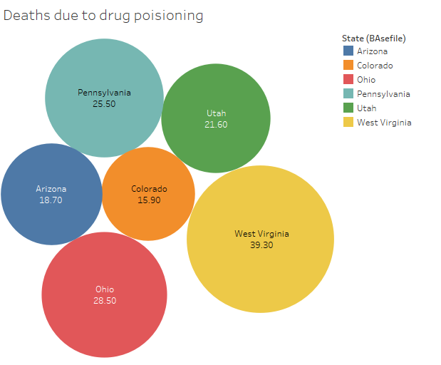
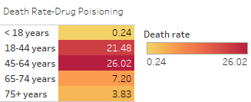
Drug poisoning
PRIMARY ANALYSIS
Here, we identify the number of cases and the age group where in the deaths due to drug poisoning are the highest.
It is observed that West Virginia has the highest number of deaths due to drug poisoning and is 2.5 times above the US average of 16.3.
The data suggests, that the death due to drug poisoning has been highest in the age group 45-64 years followed by 18-44 years.
SECONDARY ANALYSIS
Exposure of teens and young adults to illicit drugs has led to huge amount of deaths in West Virginia.
4 out of 5 US counties with maximum rates of drug poisoning deaths are located in West Virginia
West Virginia Mortality Rate | US Mortality Rate
39.3 | 16.3

Slide 9
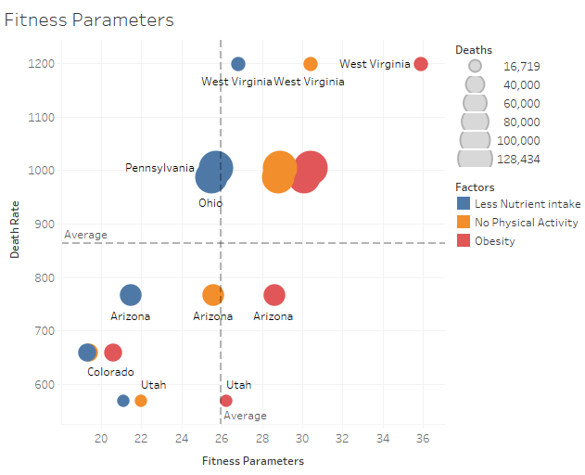
Fitness Parameters
PRIMARY ANALYSIS
Here, we identify the fitness parameters i.e. the impact of obesity, Lack of physical exercise and Less Nutrient intake on daily basis for the identified states.
This Bubble chart has been divided into 4 quadrants with the axis of reference as the average of the Death rate and the Fitness Parameter Values.
It is observed, West Virginia has all the 3 parameters very high, thus impacting the health of people in that state leading to many other diseases like heart diseases, diabetics etc., which leads to more number of deaths. It is followed by Pennsylvania and Ohio. All these states lie in the 1st Quadrant.
The data suggests that the 3 states with lower mortality rate have all the 3 parameters less than the 3 states with higher mortality rate. All these states lie in the 3rd Quadrant.
Out of all the 3 factors, Obesity has been quite high than the other two fitness parameters.

Slide 10
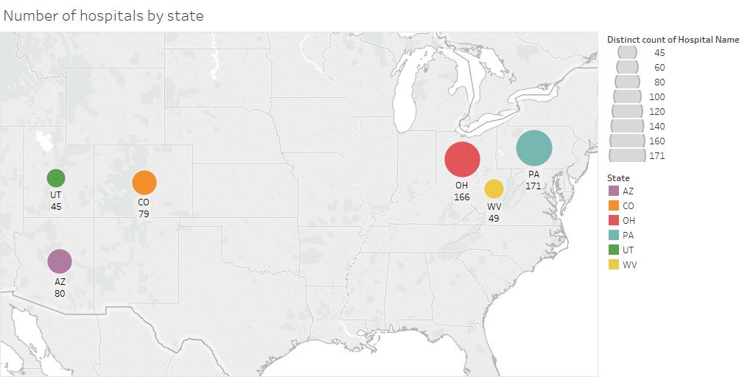
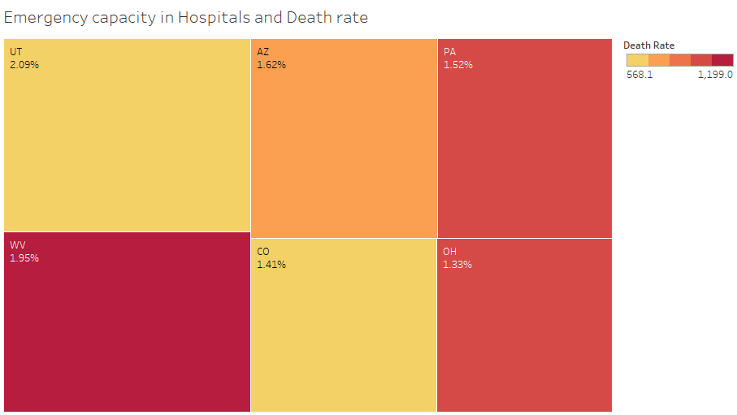
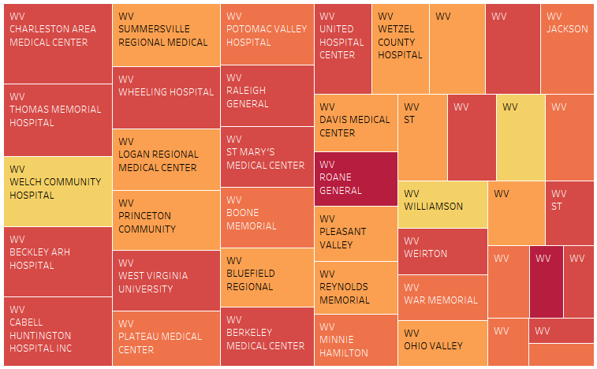
Hospital parameters
PRIMARY ANALYSIS
Here, we identify the number of hospitals and the emergency capacity in hospitals for the identified states.
It is observed that two of the higher mortality states Ohio and Pennsylvania have higher number of hospitals, but the heat map of emergency capacity is less compared to other states. So, it can intake more patients but less number of emergency cases. This also leads to more number of deaths which could be due to any emergency situation.
On the other hand West Virginia has more emergency capacity but less number of hospitals. This signifies less preventable hospitalizations, leading to more number of deaths as not able to admit more patients or lack of awareness of diseases.
The heat Map on the right indicates the hospitals which have higher death rates.
The other 3 states have less number of emergency capacity and average number of hospitals compared to higher mortality states.

Slide 11
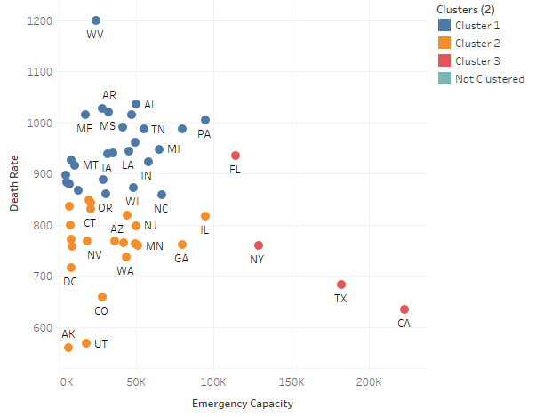
Clustering analysis
Since emergency capacity of hospital is a significant factor, we did a clustering analysis to categorize all the states in US.
This clustering analysis provides 3 major clusters of states, which follow similar likelihood.

Slide 12
Conclusion
Analysis of multiple parameters affecting mortality lead to following conclusion:
Ethnic Stereotype : Though racial discrimination is against ethical/social responsibility, but primary analysis suggest that mortality is higher for some specific ethnic groups like Blacks and certain age groups. There is a reason to investigate more on the core factors responsible for this trend and create awareness to mitigate this issue.
Social/Behavioral Stereotype : Though physical discrimination is against social responsibility, but primary analysis suggest that Fitness parameters like Obesity and eating habits of less nutrient is highly correlated with mortality rate.
Moral Factors : Crime rate and Alcohol abuse is also a major factor responsible for high mortality . There is an opportunity to improve infrastructure and legislation strictness to reduce Crime rate and Alcohol abuse deaths.
Pharmacy Factors : Drug positioning is also an important factor responsible for high mortality . There is an opportunity to improve infrastructure and awareness to reduce Drug positioning deaths.
Potential Piracy Issue : Hospital data of names and diseases the patients have been admitted for and which hospital names have higher death rate has the privacy issue, but details about emergency admission capacities of hospitals in different region is a useful parameter to cluster state on mortality. As less preventable hospitalizations lead to more deaths in high mortality states.

